Slide 1
Introducing the Economy

Slide 2
Scope of Macroeconomics
Macroeconomics is concerned with the behaviour of the economy as a whole—with booms and recessions, the economy’s total output of goods and services, the growth of output, the rates of inflation and unemployment, the balance of payments, and exchange rates.
Macroeconomics deals with both long-run economic growth and the short-run fluctuations that constitute the business cycle.
Macroeconomics focuses on the economic behavior and policies that affect consumption and investment, the trade balance, the determinants of changes in wages and prices, monetary and fiscal policies, the money stock, the budget, interest rates, and national debt.
Macroeconomics goes beyond details of the behavior of individual economic units, such as households and firms, or the determination of prices in particular markets, which are the subject matter of microeconomics.

Slide 3
In macroeconomics we deal with the market for goods as a whole, treating all the markets for different goods—such as the markets for agricultural products and for medical services—as a single market. Similarly, we deal with the labour market as a whole, abstracting from differences between the markets for, say, unskilled labour and doctors.
The benefit of the abstraction is that it facilitates increased understanding of the vital interactions among the goods, labour, and assets markets. The cost of the abstraction is that omitted details sometimes matter.
A fundamental question in macroeconomics is whether the government can and should intervene in the economy to improve its performance.

Slide 4
GDP: Production and Income
The measure of aggregate output in the national income accounts is called the gross domestic product, or GDP, for short.
To understand how GDP is constructed, it is best to work with a simple example. Consider an economy composed of just two firms. Firm 1 produces steel, employing workers and using machines to produce the steel. It sells the steel for Rs 100 to Firm 2, which produces cars. Firm 1 pays its workers Rs 80, leaving Rs 20 in profit to the firm.
Firm 2 buys the steel and uses it, together with workers and machines, to produce cars. Revenues from car sales are Rs 200. Of the Rs 200, Rs 100 goes to pay for steel and Rs 70 goes to workers in the firm, leaving Rs 30 in profit to the firm.
The aggregate output in this economy would be just the value of cars, the final good. Steel output is not counted as it is an intermediate good, one which is used in the production of final good. The inclusion of steel would lead to double counting.

Slide 5
Definitions of GDP
GDP Is the value of the final goods and services produced in the economy during a given period. We want to count only the production of final goods, not intermediate goods. Suppose both the firms merged, steel sale would not be recorded. All we would see is the output of the final product, cars. That is to say the definition of aggregate output does not depend on whether firms decide to merge or not.
GDP is the sum of value added in the economy during a given period. The value added by a firm is defined as the value of its production minus the value of the intermediate goods used in production. In our two-firms example, the steel company does not use intermediate goods. Its value added is simply equal to the value of the steel it produces, Rs 100. The car company, however, uses steel as an intermediate good. Thus, the value added by the car company is equal to the value of the cars it produces minus the value of the steel it uses in production, Rs 200 - Rs 100 = Rs 100. Total value added in the economy, or GDP, equals Rs 100 + Rs 100 = Rs 200.
Note that aggregate value added would remain the same if the steel and car firms merged and became a single firm. In this case, we would not observe intermediate goods at all—as steel would be produced and then used to produce cars within the single firm—and the value added in the single firm would simply be equal to the value of cars, Rs 200

Slide 6
Put together, the two definitions imply that the value of final goods and services—the first definition of GDP—can also be thought of as the sum of the value added by all the firms in the economy—the second definition of GDP.
GDP is also equal to the sum of incomes in an economy during a given period. Think about the revenues left to a firm after it has paid for its intermediate goods: Some of the revenues go to pay workers—this component is called labour income. The rest goes to the firm—that component is called capital income or profit income.
Of the Rs 100 of value added by the steel manufacturer, Rs 80 goes to workers (labor income) and the remaining Rs 20 goes to the firm (capital income). Of the Rs 100 of value added by the car manufacturer, Rs 70 goes to labour income and Rs 30 to capital income.
For the economy as a whole, labour income is equal to Rs 150 (Rs 80 + Rs 70), capital income is equal to Rs 50 (Rs 20 + Rs 30). Value added is equal to the sum of labor income and capital income is equal to Rs 200 (Rs 150 + Rs 50).

Slide 7
Nominal and Real GDP
Nominal GDP is the sum of the quantities of final goods produced times their current price. This definition makes clear that nominal GDP increases over time for two reasons:
First, the production of most goods increases over time.
Second, the prices of most goods also increase over time.
If our goal is to measure production and its change over time, we need to eliminate the effect of increasing prices on our measure of GDP. That’s why real GDP is constructed as the sum of the quantities of final goods times constant (rather than current) prices.
Nominal and real GDP are equal (by construction) in the year for which we take the reference (constant) price level. Real GDP is also called GDP in terms of goods, GDP in constant rupees or GDP adjusted for inflation.
In January 2015, Indian government moved to a new base year of 2011-12 from the earlier the base year of 2004-05 for national accounts.

Slide 8
GDP: Level versus Growth Rate
We have focused so far on the level of real GDP. This is an important number that gives the economic size of a country. A country with twice the GDP of another country is economically twice as big as the other country. Equally important is the level of real GDP per person, the ratio of real GDP to the population of the country. It gives us the average standard of living of the country.
In assessing the performance of the economy from year to year, economists focus, however, on the rate of growth of real GDP, often called GDP growth. Periods of positive GDP growth are called expansions. Periods of negative GDP growth are called recessions.

Slide 9
GDP Purchasing Power Parity
Purchasing power parity (PPP) is the measurement of prices in different countries that uses the prices of specific goods to compare the absolute purchasing power of the countries' currencies, and, to some extent, their people's living standards. PPP produces an inflation rate equal to the price of the basket of goods at one location divided by the price of the basket of goods at a different location. The PPP inflation and exchange rate may differ from the market exchange rate because of tariffs, and other transaction costs.
Poverty, tariffs, transportation and other frictions prevent trading and purchasing of various goods, so measuring a single good can cause a large error. The PPP term accounts for this by using a basket of goods, that is, many goods with different quantities. PPP then computes an inflation and exchange rate as the ratio of the price of the basket in one location to the price of the basket in the other location.

Slide 10
For example, if a basket consisting of 1 computer, 1 ton of rice, and half a ton of steel was 1000 US dollars in New York and the same goods cost 60000 rupees in Mumbai, the PPP exchange rate would be 60 Indian rupee for every 1 US dollar.
Because PPP exchange rates are more stable and are less affected by tariffs, they are used for many international comparisons, such as comparing countries' GDPs or other national income statistics. These numbers often come with the label PPP-adjusted.

Slide 11
GDP and GNP
GDP is the total output of goods and services within the economy (i.e. domestic boundary) irrespective of whether that output (income) is attributable to entities resident inside or outside the economy. GNP is the total output of goods and services (income) attributable to entities resident within the economy irrespective of whether that output was created inside or outside the economy.
For instance, part of Indian GDP corresponds to the profits earned by Honda from its Indian manufacturing operations. These profits are part of Japan’s GNP, because they are the income of Japanese-owned capital.
GNP= GDP+ Net factor Income from Abroad. Factor income includes interest and dividends earned on financial and real capital assets working abroad, as well as wages, salaries, and other labor income earned by domestic residents working outside the country. Thus, GNP can be greater than or lesser than GDP depending on whether Net factor income is positive or negative.

Slide 12
GDP and NDP
Capital wears out, or depreciates, while it is being used to produce output. Net domestic product (NDP) is equal to GDP minus depreciation.
NDP thus comes closer to measuring the net amount of goods produced in the country in a given period: It is the total value of production minus the value of the amount of capital used up in producing that output.

Slide 13
Uses of GDP
GDP provides a direct indication of the health and growth of the economy. Hence, businesses can use GDP as a guide to their business strategy.
Comparing the GDP growth rates of different countries can play a part in asset allocation, aiding decisions about whether to invest in fast-growing economies abroad—and if so, which ones.
Government and the central bank use the growth rate and other GDP statistics as part of their decision process in determining what type of fiscal and monetary policies to implement.

Slide 14
Problems in GDP measurement
GDP growth alone cannot measure a nation’s development or its citizens’ well-being, as noted above. For instance, a nation may be experiencing rapid GDP growth, but this may impose a significant cost to society in terms of environmental impact and an increase in income disparity.
GDP relies on recorded transactions and official data, so it does not take into account the extent of informal economic activity or the black economy. Further, some outputs are poorly measured because they are not traded in the market. If you cook rice, the value of your labour isn’t counted in official GDP statistics.

Slide 15
Some activities measured as adding to GDP in fact represent the use of resources to avoid or contain “bads” such as crime or risks to national security. Similarly, the accounts do not subtract anything for environmental pollution and degradation. For instance, one study of Indonesia claims that properly accounting for environmental degradation would reduce the measured growth rate of the economy by 3 percent.
It is difficult to account correctly for improvements in the quality of goods. This has been the case particularly with electronic gadgets and computers, whose quality has improved dramatically while their price has fallen sharply.

Slide 16
Important facts
National Income in India is calculated by the National Statistical Office which comes under the Ministry of Statistics and Programme Implementation.
The first estimation of National Income was done under the Ministry of Commerce during the years 1948-49. P C Mahalanobis was the Chairman of the first National Income Committee.
The First rough estimate of National Income was made by Dadabhai Naoroji for the year 1867-68 which is mentioned in his book Poverty and Unbritish Rule in India.
The First Scientific estimate was made by Professor V K R Rao in 1931-32.

Slide 17
The Unemployment Rate
Employment is the number of people who have a job. Unemployment is the number of people who do not have a job but are looking for one. The labour force is the sum of employment and unemployment
Labour force= employed + unemployed
The unemployment rate is the ratio of the number of people who are unemployed to the number of people in the labour force. Most countries rely on large surveys of households to compute the unemployment rate. India has the Periodic Labour Force Survey.
Note that only those looking for a job are counted as unemployed; those who do not have a job and are not looking for one are counted as not in the labour force. When unemployment is high, some of the unemployed give up looking for a job and therefore are no longer counted as unemployed. These people are known as discouraged workers.

Slide 18
If all workers without a job gave up looking for one, the unemployment rate would equal zero. This would make the unemployment rate a very poor indicator of what is happening in the labour market. This example is too extreme; in practice, when the economy slows down, we typically observe both an increase in unemployment and an increase in the number of people who drop out of the labour force.
Equivalently, a higher unemployment rate is typically associated with a lower participation rate, defined as the ratio of the labour force to the total population of working age. The working age population is defined as those aged 15 to 64.

Slide 19
The Inflation Rate
Inflation is a sustained rise in the general level of prices—the price level. The inflation rate is the rate at which the price level increases. (Symmetrically, deflation is a sustained decline in the price level. It corresponds to a negative inflation rate).
The practical issue is how to define the price level so the inflation rate can be measured. Macroeconomists typically look at at three price indexes: the GDP deflator and the Consumer Price Index and the Wholesale Price Index.
Increases in nominal GDP can come either from an increase in real GDP, or from an increase in prices. Put another way, if we see nominal GDP increase faster than real GDP, the difference must come from an increase in prices. The GDP deflator in year t, P_{t} , is defined as the ratio of nominal GDP to real GDP in year t

Slide 20
The GDP deflator is called an index number and has no economic interpretation. But its rate of change, (P_{t} - P_{t-1}) / P_{t-1} has a clear economic interpretation: It gives the rate at which the general level of prices increases over time—the rate of inflation.
One advantage to defining the price level as the GDP deflator is that it implies a simple relation among nominal GDP, real GDP, and the GDP deflator. Nominal GDP is equal to the GDP deflator times real GDP. Or, putting it in terms of rates of change: The rate of growth of nominal GDP is equal to the rate of inflation plus the rate of growth of real GDP.

Slide 21
Consumer Price Index
The GDP deflator gives the average price of output—the final goods produced in the economy. But consumers care about the average price of consumption—the goods they consume. The two prices need not be the same.
The set of goods produced in the economy is not the same as the set of goods purchased by consumers, for two reasons:
Some of the goods in GDP are sold not to consumers but to firms (machine tools, for example), to the government, or to foreigners.
Some of the goods bought by consumers are not produced domestically but are imported from abroad.

Slide 22
To measure the average price of consumption, or, equivalently, the cost of living, macroeconomists look at another index, the Consumer Price Index, or CPI which is based on a basket of goods. India has CPI, CPI Rural, CPI Urban and CPI Industrial Workers.
RBI sets the target of CPI for controlling the inflation in its monetary policy. There are four CPI in India for four different set of workers:
CPI (Industrial Workers)
CPI (Urban Non- Manual Employees)
CPI (Agricultural Labour)
CPI (Rural Worker)

Slide 23
In India, CPI (Rural/Urban/Combined) is published by the Central Statistics Office (Ministry of Statistics and Programme Implementation) and CPI (IW/AL) is published by Labour Bureau in the Ministry of Labour and Employment. It is published on monthly basis.
The items covered in CPI are divided into eight categories viz. Education, communication, transportation, recreation, apparel, foods and beverages, housing and medical care. The number of items in CPI basket include 448 in rural and 460 in urban.

Slide 24
Wholesale Price Index
WPI is average price changes of goods that are traded in the wholesale market. It is a weekly measure of wholesale price movement of the economy. It includes only the prices of goods and does not include items pertaining to services. In India, WPI is published by the Office of Economic Adviser, Ministry of Commerce and Industry weekly. It has a time lag of two weeks.
There are 697 items are included in the index. These items are further divided into three categories:
Primary articles: The Primary articles are food items, non-food items and minerals. There are 117 items for Primary Articles (weightage 22.62%)
Fuel and Power: It includes power, light and lubricants, electricity, coal mining and mineral oil. There are 16 items for Fuel & Power. (weightage 13.15%)
Manufactured Goods: It includes food products, beverages, tobacco and tobacco products, wood and wood products, textiles, paper and paper products, basic metals, alloys, rubber and rubber products etc. There are 564 items for Manufactured Products. (weightage 64.23%)

Slide 25


General Price Indices
Price indices are used to monitor changes in prices levels over time. This is useful when separating real income from nominal income, as inflation is a drain on purchasing power. The two most basic indices are the Laspeyres index and the Paasche index
They work by dividing expense on a specific basket in the current period (the sum of p*q for each product in the basket considered when calculating the index) by how much the same basket would cost in the base period (period 0). The main difference is the quantities used: the Laspeyres index uses q₀ quantities, whereas the Paasche index uses period n quantities.

Slide 26
Why do economists care about inflation?
If a higher inflation rate meant just a faster but proportional increase in all prices and wages—a case called pure inflation—inflation would be only a minor inconvenience, as relative prices would be unaffected.
Take, for example, the workers’ real wage—the wage measured in terms of goods rather than in rupees. In an economy with 10% more inflation, prices would increase by 10% more a year. But wages would also increase by 10% more a year, so real wages would be unaffected by inflation.

Slide 27
However, there is no thing such as pure inflation. During periods of inflation, not all prices and wages rise proportionately. Because they don’t, inflation affects income distribution. For example, retirees in many countries receive payments that do not keep up with the price level, so they lose in relation to other groups when inflation is high.
Inflation leads to other distortions. Variations in relative prices also lead to more uncertainty, making it harder for firms to make decisions about the future, such as investment decisions. Some prices, which are fixed by law or by regulation, lag behind the others, leading to changes in relative prices.

Slide 28
Okun’s Law
Intuition suggests that if output growth is high, unemployment will decrease, and this is indeed true. This relation was first examined by American economist Arthur Okun and for this reason has become known as Okun’s law. It predicts that a 1% increase in unemployment will usually be associated with a 2% drop in gross domestic product (GDP).
This is why unemployment goes up in recessions and down in expansions. This relation has a simple but important implication: The key to decreasing unemployment is a high enough rate of growth.
This is for two reasons. The first is that population, and thus the labour force, increases over time, so employment must grow over time just to keep the unemployment rate constant. The second is that output per worker is also increasing with time, which implies that output growth is higher than employment growth.

Slide 29
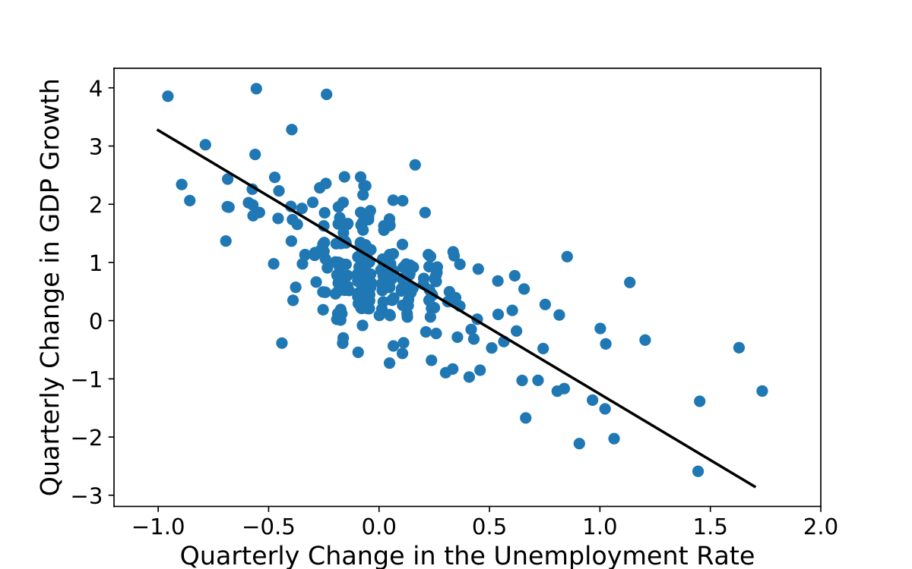

Slide 30
Phillips Curve
Okun’s law implies that, with strong enough growth, one can decrease the unemployment rate to very low levels. But intuition suggests that, when unemployment becomes very low, the economy is likely to overheat, and that this will lead to upward pressure on inflation.
This relation was first explored in 1958 by a New Zealand economist, A. W. Phillips, and has become known as the Phillips curve. Phillips plotted the rate of inflation against the unemployment rate.

Slide 31
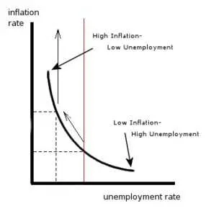

Slide 32
Short, Medium and Long Run
Movements in output come from movements in the demand for goods. Factors that affect demand like consumer confidence and interest rates affect aggregate output.
How much can be produced depends on how advanced the technology of the country is, how much capital it is using, and the size and the skills of its labour force. These are the fundamental determinants of a country’s level of output.
The technological sophistication of a country depends on its ability to innovate and introduce new technologies. The size of its capital stock depends on how much people save. The skills of workers depend on the quality of the country’s education system. Other factors are also important: If firms are to operate efficiently, for example, they need a clear system of laws under which to operate and an honest government to enforce those laws.
This suggests a third answer: The true determinants of output are factors like a country’s education system, its saving rate, and the quality of its government.

Slide 33
In the short run, say, a few years, year-to-year movements in output are primarily driven by movements in demand. Changes in demand, perhaps due to changes in consumer confidence or other factors, can lead to a decrease in output (a recession) or an increase in output (an expansion).
In the medium run, say, a decade, the economy tends to return to the level of output determined by supply factors: the capital stock, the level of technology, and the size of the labor force. And, over a decade or so, these factors move sufficiently slowly that we can take them as given.
In the long run, say, a few decades or more, the third answer is the right one. To understand why China has been able to achieve such a high growth rate since 1980, we must understand why both the capital stock and the level of technology in China are increasing so fast. To do so, we must look at factors like the education system, the saving rate, and the role of the government.

